Slide 1
SEARCH ENGINE OPTIMIZATION
AUDIT
APPOLO PHARMACY WEBSITE
Internship Project
B S CHANNABASAPPA FIRST GRADE COLLEGE
PREPARED BY:
SYED ABDUL ADEEB
INTERNSHIP ORGANIZATION:
GLOW LOGIC

Slide 2
Introduction
This presentation reviews the Apollo Pharmacy website from an SEO perspective.
The audit looks at how easily users and search engines can find and understand its pages.
It covers technical SEO, on-page content, site structure, mobile usability, and local search.
The aim is to identify improvement opportunities—not to claim access to Apollo Pharmacy’s private analytics

Slide 3
Contents
About Apollo Pharmacy and its website
Website structure and key pages
Keyword research
Technical SEO
page speed
Backlink overview
Recommendations
Conclusion

Slide 4

About Apollo Pharmacy
Apollo Pharmacy is an online pharmacy and retail brand in India.
Its website lets customers browse medicines and health, wellness, and personal-care products.
The site also helps users find pharmacy stores.
This audit focuses on the public-facing website, not Apollo Pharmacy’s internal analytics.

Slide 5
Website Structure and Key Pages
Main navigation: Buy Medicines, Find Doctors, Lab Tests, Circle Membership, Health Records, Credit Card, and Buy Insurance.
Product categories: Apollo Products, Baby Care, Nutritional Drinks & Supplements, Women Care, Personal Care, Ayurveda, Health Devices,
Home Essentials, and Health Condition.
Homepage features: Medicine search, a medicine offer, Doctor Appointment, Health Insurance, and Lab Tests at Home.
Health condition links: Diabetes Care, Cardiac Care, Stomach Care, Pain Relief, and Liver Care.
Account and support: Delivery address, cart, login, and a WhatsApp contact button.

Slide 6
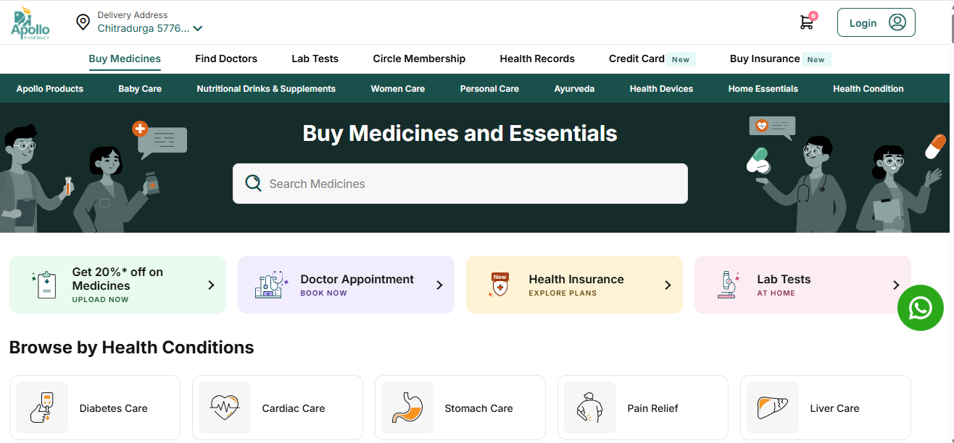
Home page(Buy Medicine)

Slide 7
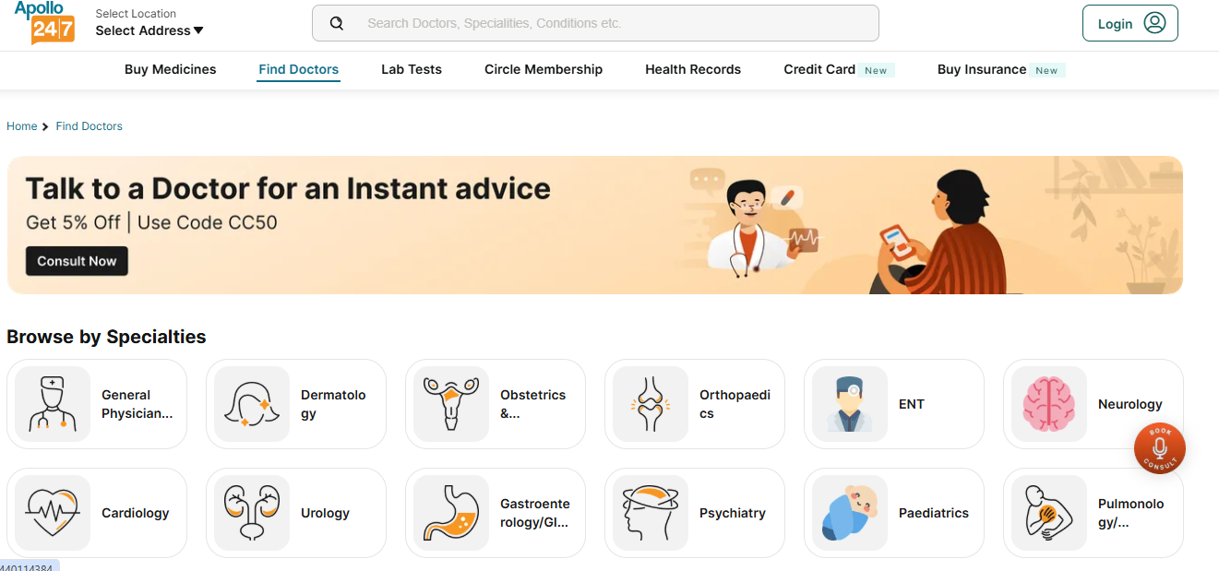
Home(Find Doctors)

Slide 8
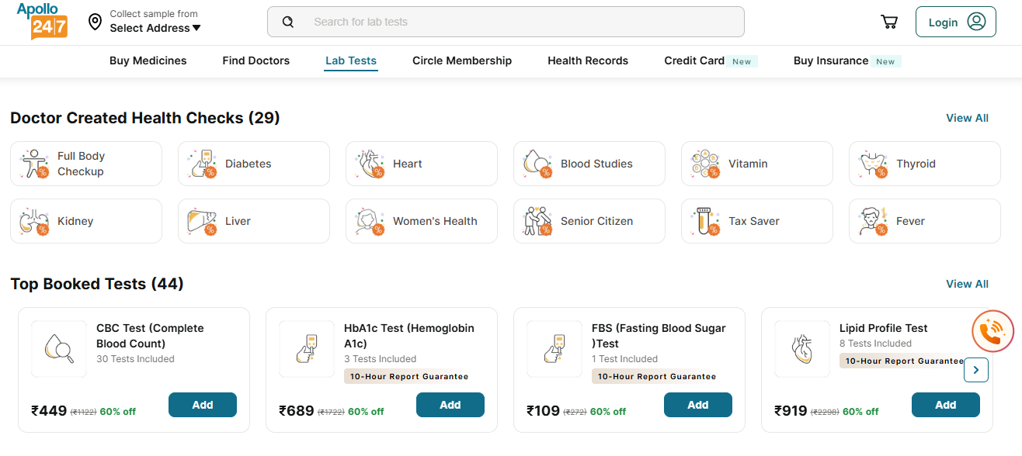
Home(Lab Tests)

Slide 9
Keyword Research
Search intent | Example keywords | Relevant page
Buy medicines | “buy medicines online” | Buy Medicines
Shop a category | “baby care products”, “women care products”, “health devices” | Matching product category
Find a service | “book doctor appointment”, “lab tests at home” | Doctor or Lab Tests
Browse health needs | “diabetes care products”, “cardiac care products” | Health Conditions

Slide 10
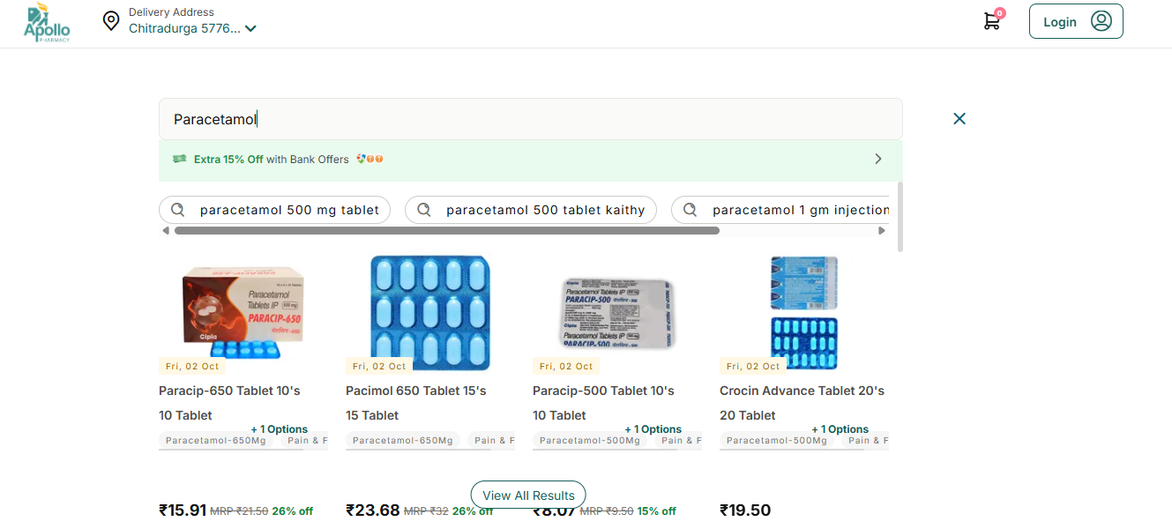

Slide 11
Technical SEO
Mobile usability: The website was easy to use on my phone. The navigation, medicine search, and key service links were accessible.
HTTPS: The homepage opens using a secure https:// address.
Broken links: No broken links were found in the homepage links tested; they opened the expected pages.
Google Search Console: Its private data requires website ownership verification or access from an owner we can’t present Apollo’s private data as part of this public audit.
Indexing signals: Good for the pages checked The tested pages were discoverable in Google Search.

Slide 12
Page Speed Insights
REPORT THE MOBILE RESULTS:-
Page tested: Apollo Pharmacy (www.apollopharmacy.in )
Device: Mobile
Performance score: 33/ 100
Largest Contentful Paint (LCP):17.0s
Cumulative Layout Shift (CLS): 0.0
First Contentful Paint(FCP):4.5 s

Slide 13
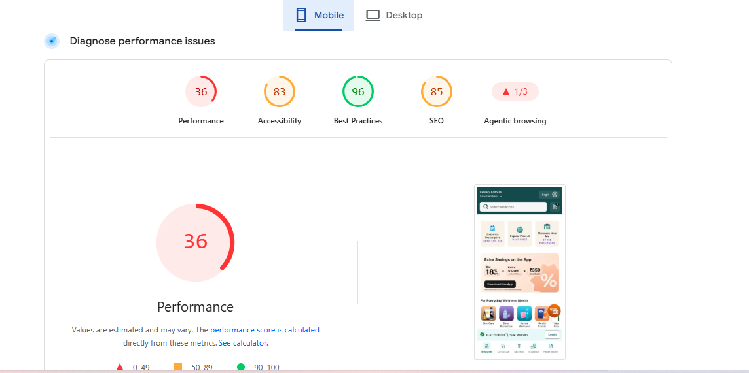

Slide 14
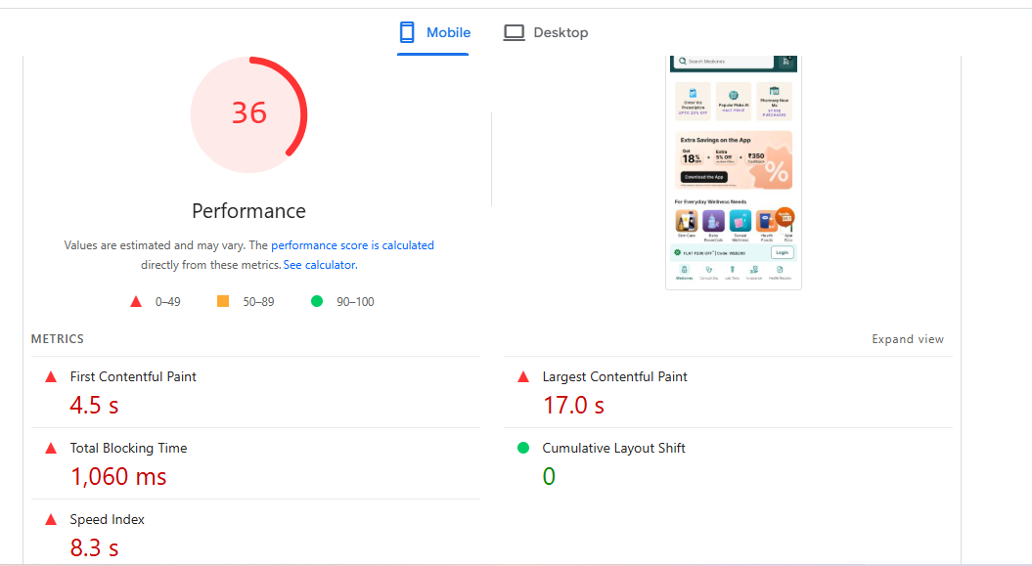

Slide 15
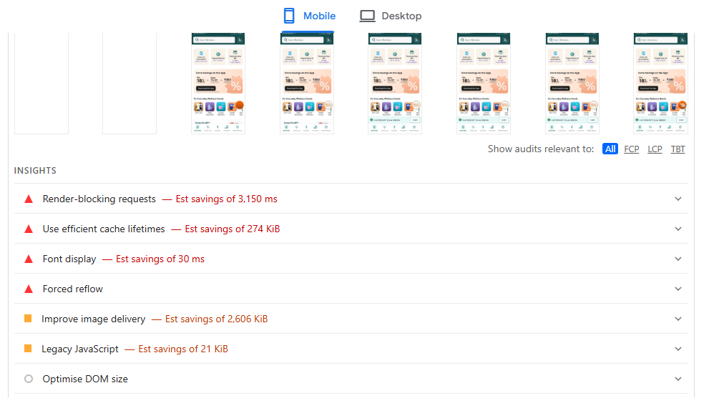

Slide 16
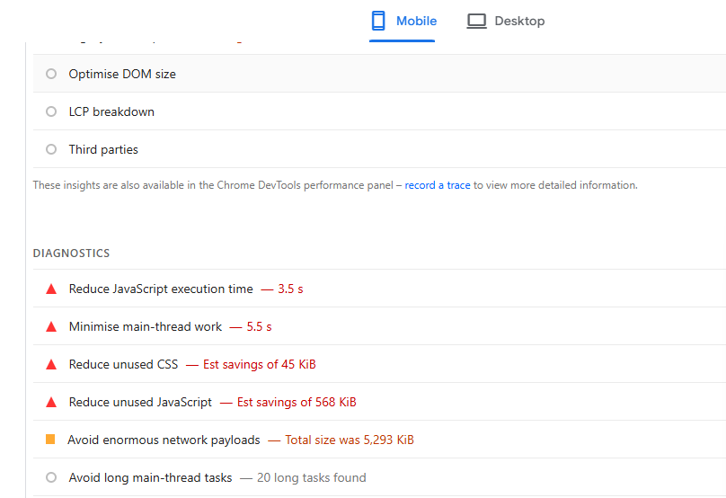

Slide 17
Main improvement suggestions:
Optimize the largest visible page element to reduce LCP from 17.0 seconds.
Reduce or defer JavaScript and CSS that delay page loading.
Keep CLS at 0.00 by reserving space for images and banners.
Re-test on mobile after changes and compare the Page Speed score.

Slide 18
REPORT THE MOBILE RESULTS:-
Page tested: Apollo Pharmacy (www.apollopharmacy.in )
Device: Desktop
Performance score: 69/ 100
Largest Contentful Paint (LCP):1.5s
Cumulative Layout Shift (CLS): 0.0
First Contentful Paint(FCP):0.8s

Slide 19
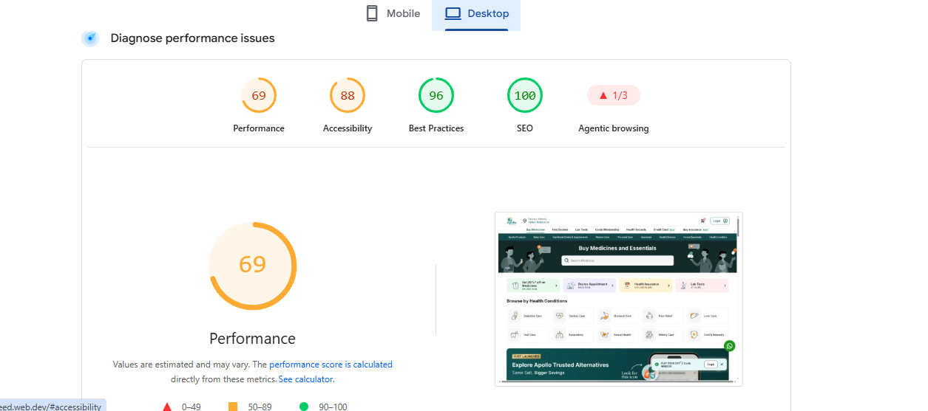

Slide 20
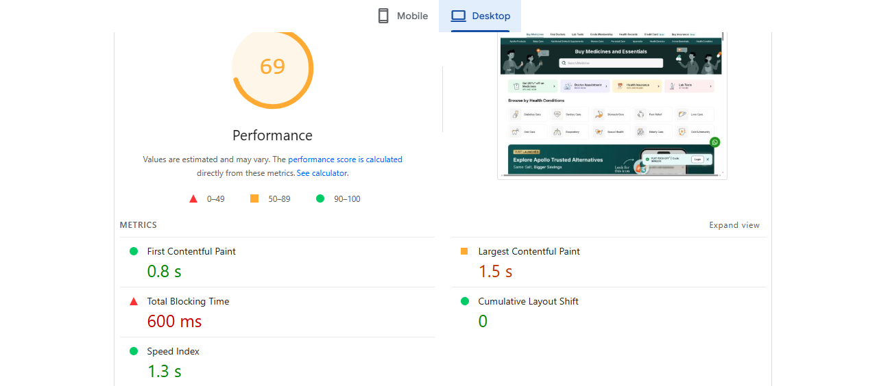

Slide 21
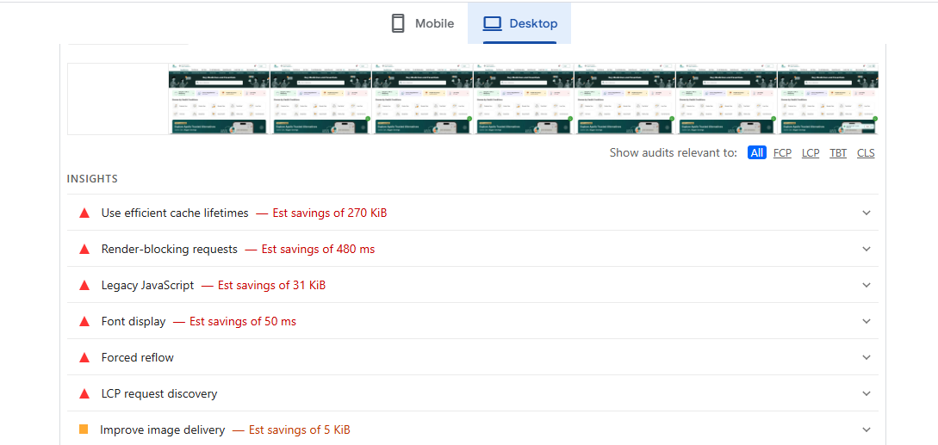

Slide 22
Main improvement suggestions:
Review Page Speed Insights’ Opportunities and fix its highest-impact items first.
Reduce unused JavaScript and CSS; defer scripts that aren’t needed to display the page.
Optimize images and enable efficient caching where the report recommends it.
Re-test on desktop after changes and compare the score.

Slide 23
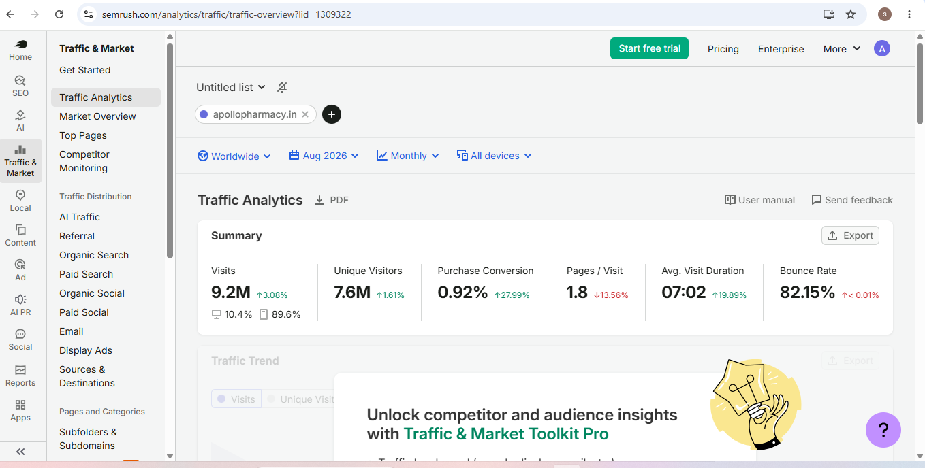

Slide 24
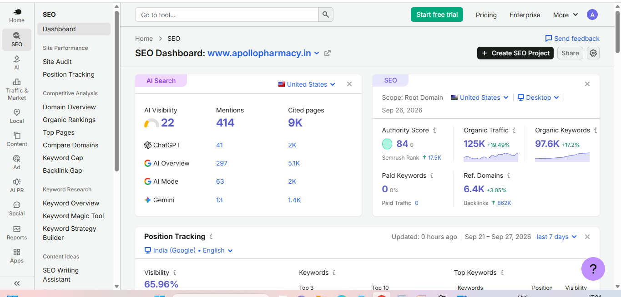

Slide 25
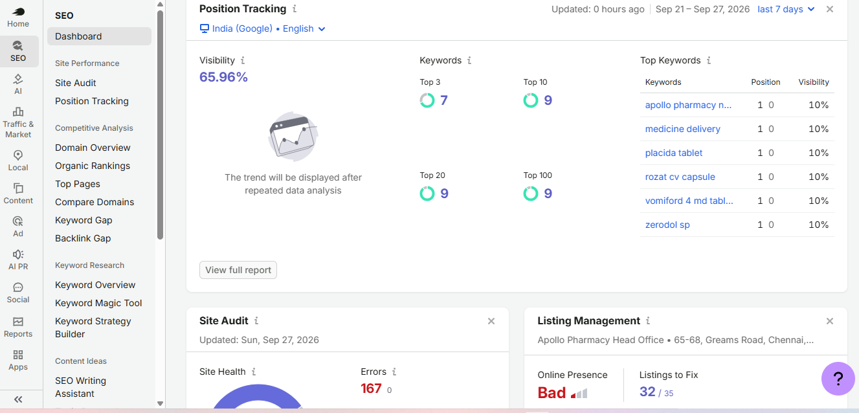

Slide 26
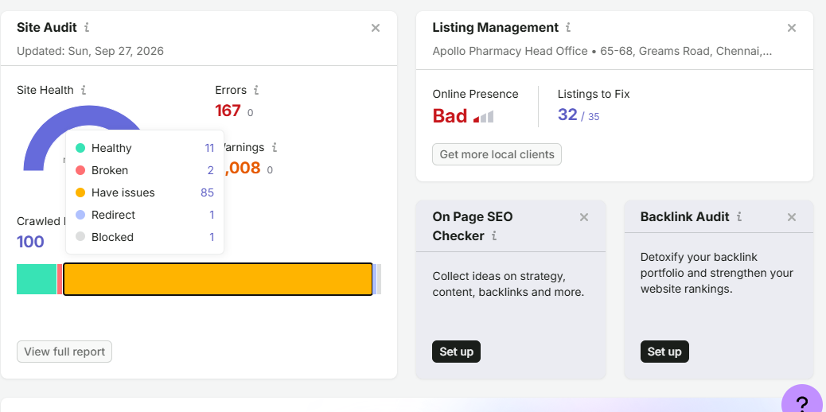

Slide 27
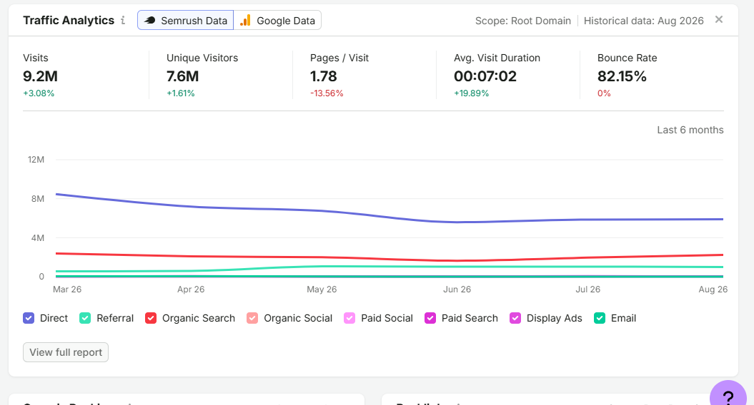

Slide 28
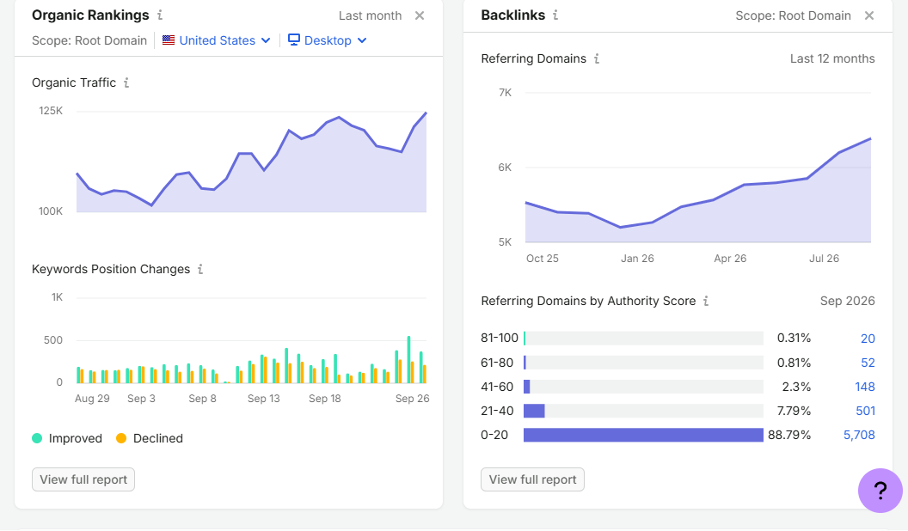

Slide 29
Recommendations
Implement Medical Reviewer Bylines:-Ensure every informational blog post, medicine guide, or condition page explicitly states who wrote the content and who medically reviewed it.
Dynamic Citations for Clinical Claims:-Any page discussing drug side effects, dosages, or health conditions must link out to high-authority, peer-reviewed medical sources like PubMed, NIH, or the WHO.
Outdated Content Decay Check:-Medical guidelines change. Recommend a content pruning or optimization schedule to ensure old health articles are updated with current medical terminology and data.

Slide 30
Programmatic Store Landing Pages:-Audit their store locator setup. Every physical branch should have a unique, indexable URL (e.g., apollopharmacy.in/stores/bengaluru/indiranagar).
Clean Up Faceted Navigation:-E-commerce filters (sorting by brand, price, dosage, or pack size) can generate millions of duplicate URLs.
Eliminate Keyword Cannibalization on Medicine Pages:-Often, generic medicine names (e.g., Paracetamol) conflict with branded variants (e.g., Crocin).
Build Topic Clusters for Chronic Illnesses:-Group content logically around major disease states (e.g., Diabetes, Hypertension, Cardiac Care).

Slide 31
Target Long-Tail "Substituted" Search Intent:-Patients frequently search for alternatives to expensive medicines (e.g., "cheaper substitute for [Drug Name]").
Core Web Vitals Optimization:-Check mobile speed performance—specifically Largest Contentful Paint (LCP) and Cumulative Layout Shift (CLS). E-commerce sites with slow product page load times suffer from reduced search rankings and higher cart abandonment.
Search & Navigation UX:-Ensure that the site wide search function is easily crawlable by search bots via HTML sitemaps, enabling Google to discover buried products easily.

Slide 32
Conclusion
Apollo Pharmacy’s website provides clear routes to medicines, product categories, health conditions, and related services. The homepage links tested opened as expected.
The customer journey moves from awareness through search and categories, to consideration of products and services, purchase through medicine ordering, and retention through features such as Circle Membership.
In the desktop PageSpeed test, the site scored 69/100. LCP (1.5 seconds) and CLS (0.00) were good, but the overall performance score still needs improvement.

Slide 33
Priorities are to follow PageSpeed Insights’ specific recommendations, strengthen SEO on important category pages, and verify that key pages are included in the sitemap and accessible for crawling.
This project reviewed public pages and selected links; private Search Console data and full-site indexing coverage were not available.
Apollo Pharmacy offers clear shopping and service pathways, with opportunities to improve page performance and search visibility.

Slide 34


